Slide 1
C# cơ bản

Slide 2
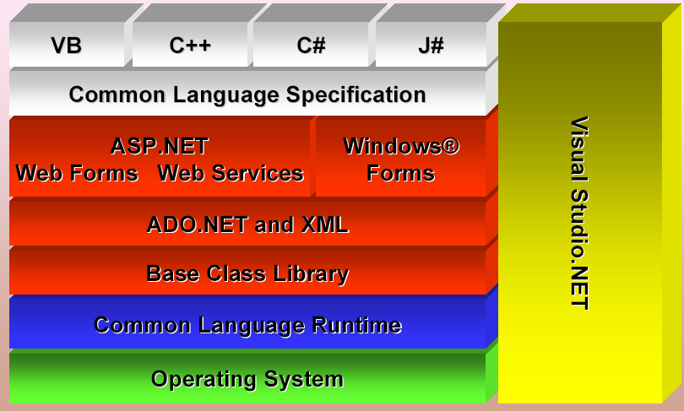
.Net framework

Slide 3
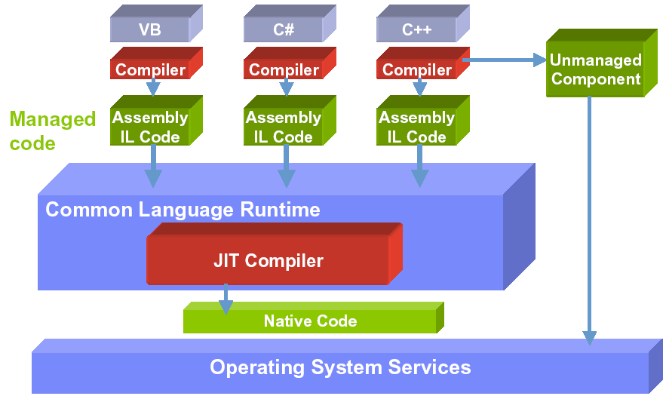
Mechanism

Slide 4
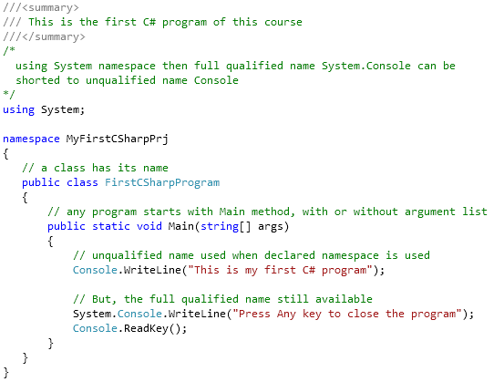
Hello world

Slide 5
Artifact
Build => Error
Run vs Run without debugging
Release
Debug
Breakpoint & watch
Step in & Step over
Watch
Set as startup project
Open project location

Slide 6
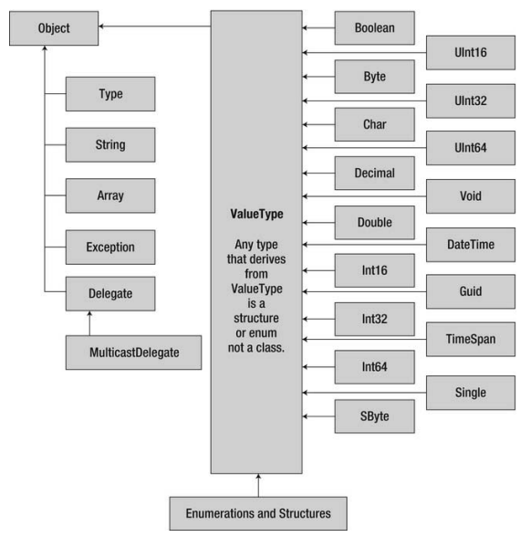
Types

Slide 7
Variable
int i; // Simple variable
// Many variables can have the same type declaration
float x, y, z;
byte x = 1, y, z = 3;
string name = "new name";
// Array: Indexed by an integer from Zero
int x[] = {1, 2, 3}; // compile error
int[] x = {1, 2, 3}; char[] y = new char[6]; // OK
int x1 = x[0]; // 1
// Multi dimension array: same size in all item
int [,] x = {{1, 2}, {3, 4}};
int [,] x = {{1, 2}, {3, 4, 5}}; // compile error
int x2 = x[1, 0]; // 3
int [,,] x = {{{1, 2}, {3, 4}}, {{5, 6}, {7, 8}}};

Slide 8
Number casting
// Smaller type in memory size integral
// type to wider one
byte b = 5; // implicit int to byte
int i = b; // i = 5
// Wider integral type to smaller one
int i = 500;
byte j = i; // compile error
byte j = (byte)i; // i = 244
// No explicit conversion for floating
// point number

Slide 9
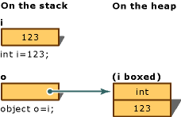
Boxing / Unboxing
Boxing: convert value type to object
Unboxing: extract value type from object

Slide 10
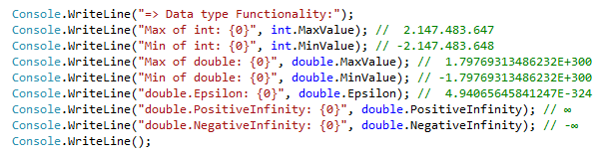
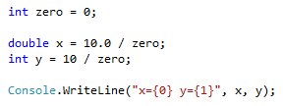
Minimum & maximum value
Result?
Notes:
Số nguyên chia cho 0 thì văng exception
Số thực chia cho 0 thì ra infinity :v

Slide 11
Operation 1/2
References: . () [] new ->
Arithmetic: + ++ - -- * / % sizeof
Logical: & | ^ !
Conditional: && (&) || ! == != > >= < <=
Type verification: is as typeof
Bitwise: ~ >> <<
Assignment: = += -= *= /= %= &= |= ^= >>= <<=
Selection: ?: ?? (not null)
Lambda expression definition: =>

Slide 12
Operation 2/2
int i = 5;
// Selection ?:
string x = i == 5 ? "Yes": "No";
int? x = 5; // nullable type
int y = x ?? 0; // Selection ?? operator
int z = x; // Error: nullable type
// cannot assign to non-nullable type
// Lambda expression – anonymous method
(int x) => x * 2; <=>
public int Double(int x){return x * 2}

Slide 13
String literal
// Declaration and initialization
// "\" start an "escape" code
string s1 = "a\n", s2 = "\"",
s3 = @"a\n", s4 = s3;
// assignment
s2 = s1;
// concatenation
s3 = s1 + s3;

Slide 14
Escape code
\a | Bell (alert) | \' | Single quotation mark
\b | Backspace | \" | Double quotation mark
\f | Formfeed | \\ | Backslash
\n | New line | \? | Literal question mark
\r | Carriage return | \ooo | ASCII character in octal notation
\t | Horizontal tab | \x hh | ASCII character in hexadecimal notation
\v | Vertical tab | \x hhhh | Unicode in herxadeximal

Slide 15
String Format
string header = String.Format(
"{0,-12}{1,8}{2,12}{1,8}{2,12}{3,14}\n", // pattern string
"City", "Year", "Population", "Change (%)"); // argument list
string body = String.Format(
"{0,-12}{1,8:yyyy}{2,12:N0}{3,8:yyyy}{4,12:N0}{5,14:P1}",
Name, BaseYear, BasePopulation, ObserveYear, ObservePopulation,
ObservePopulation – BasePopulation)/ (double) BasePopulation);
// Sample output
City Year Population Year Population Change (%)
------------------------------------------------------------------
Los Angeles 1940 1,504,277 1950 1,970,358 31.0 %
New York 1940 7,454,995 1950 7,891,957 5.9 %
Chicago 1940 3,396,808 1950 3,620,962 6.6 %
Detroit 1940 1,623,452 1950 1,849,568 13.9 %
string s = $"{x} - {y}";

Slide 16


String concatenation
Use “+” character
Use StringBuilder
Question: what should we use, + or StringBuilder?

Slide 17
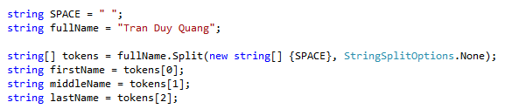
String Split
Exercise
Calculate sum of string numbers = “5, 3, 8, 11, -12, 3”
Split String fraction = “3/4” into int numerator and denominator
What if we meet 3//4?

Slide 18

String format
Positive: right align, negative: left align

Slide 19
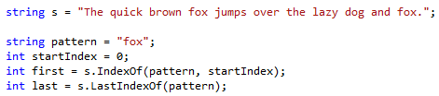
String search
Exercise
Given string s = “She sells seashells by the seashore. The shells she sells are seashells”
Calculate the number of occurrence of the word “sells” and “she”
Further reading: replace and regular expression

Slide 20
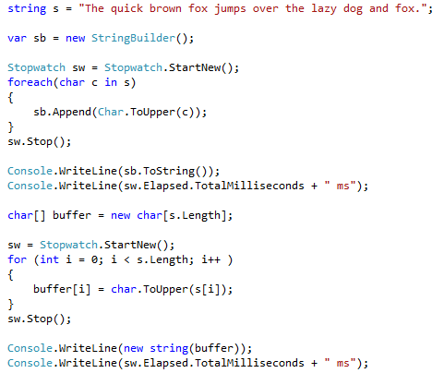

String as char array
Faster!

Slide 21
String Exercises
1. Read a string and give statistics about the number of occurrence for each of the word in the string.
2. Normalize a string of full name and print out on the screen: no more than one spaces between words, the first letter is capitalized meanwhile the rest are in lower case, no space in the beginning and the end of the string.
3. Split String fullpath = “C:\Documents\Photos\Test.jpg” into a) Containing directory b) File name c) Extension

Slide 22
DateTime
using System;
…
DateTime a = new DateTime();
// Construction complete with year, month, day,
// hour, minute, second, millisecond
DateTime b = new DateTime(2013, 06, 15, 15, 28, 31, 927);
// Current time
DateTime c = DateTime.Now;

Slide 23
Flow control
Branching
Selection: ?: ??
if… else if … else
switch … case … default
Iteration
for
foreach
do while
while
Ignore & breaking
continue
break

Slide 24
Hàm
// undefined parameter number
public void Multiply(params int[] list){}
Multiply(); // OK
Multiply(1); // OK too
Multiply(1, 2, 3, 3, 4); // still OK
Multiply(new int[] {1, 2, 3, 3, 4}); // error
// predefined parameter number
public void Multiply(int[] list){}
Multiply(); // Error
Multiply(1); // Error too
Multiply(new int[] {1, 2, 3, 3, 4}); // OK

Slide 25
Input Output param
public void Add(int a, int b, int c){
c = a + b;
}
public void AnotherAdd(int a, int b, out int c){
c = a + b;
}
…
int a = 1, b = 2, c = 5;
Add(a, b, c);
int x = c; // x = 5
AnotherAdd(a, b, out c);
x = c; // x = 3

Slide 26
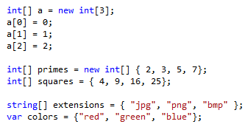
Array

Slide 27
Jagged array
// inside item can have different size
int[][] x = {{1, 2}, {3, 4, 5}};
// error: no init for jagged array allowed
int[][] x = new int[2][];
int[] x0 = {1, 2}, x1 = {3, 4, 5};
x[0] = x0;
x[1] = x1;

Slide 28
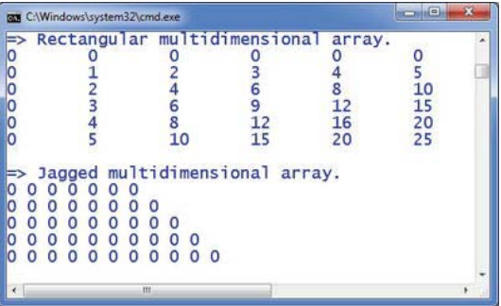
Rectangle vs Jagged array

Slide 29
Basic coding convention

Slide 30
if for do while
Trước và sau có một dong trắng
Luôn có cặp ngoặc cho dù chỉ có 1 dòng lệnh
Ngoặc ở dòng kế / trên cùng dòng (java / php / js)
Sau if luôn có else

Slide 31
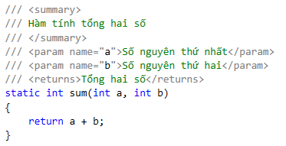
Ghi chú
Ghi chú cho mỗi đoạn lệnh
Ghi chú đối số của hàm

Slide 32
Tên hàm
Bắt đầu bằng động từ
Private: camelCase
Public: PascalCase
Ex: isPrime, doSomething
Kiểm tra phần tử tồn tại trong mảng

Slide 33
Hằng số
Viết hoa toàn bộ
ALLOWED_MAX
MAXIMUM_PATH
PascalCase

Slide 34
Viet ham kiem tra mot so nguyen n co phai so nguyen to hay khong
bool IsPrime(int number) / LaSoNguyenTo()
Viet ham tinh luy thua x^{n}
double Pow(double x, int n) / LuyThua

